Slide 1

Area 51
The Truth Lies Here …

Slide 2
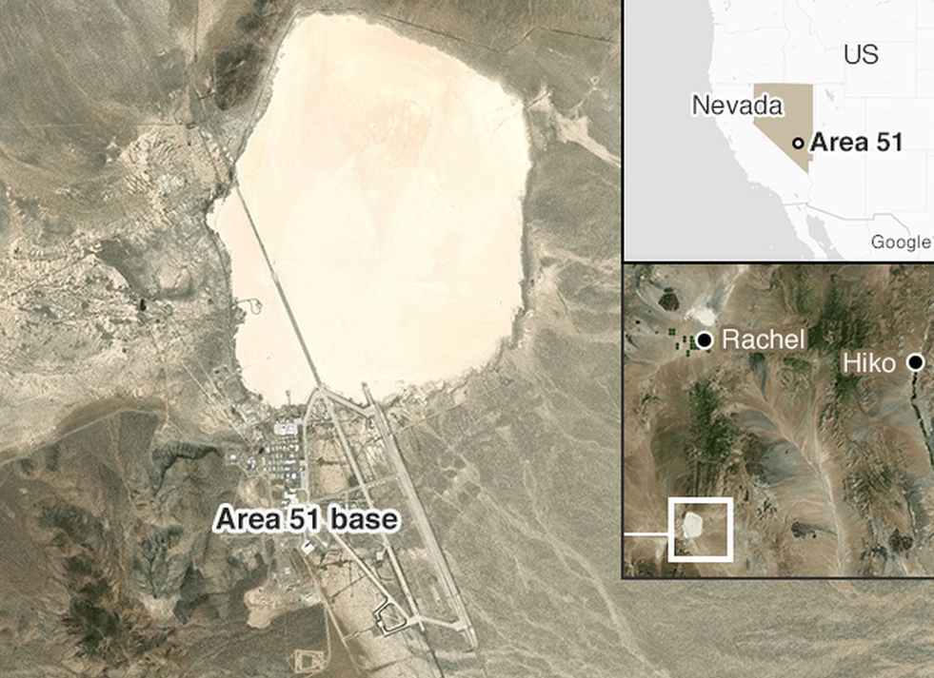
What is Area 51?
A secret and remote from settlements for years is an occasion to create a number of conspiracy theories. A secret base kept under the strict control of the military. Area 51 is a US top-secret military training ground located in the Groom Lake area between the towns of Alamo and Rachel in southern Nevada, about 145 km from Las Vegas. Located in the 51st quadrant of the Nelis Air Force Base, hence the name “Area 51”.

Slide 3
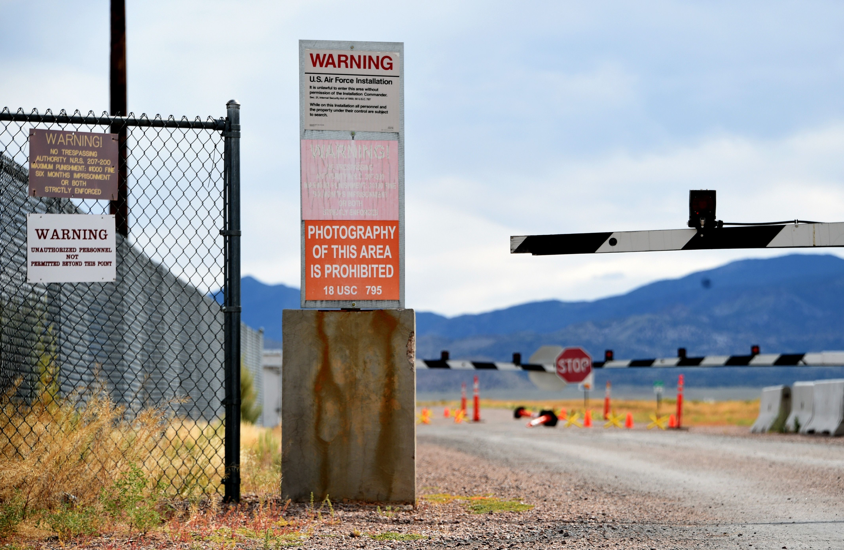
Legal status
The United States government has provided minimal information regarding Area 51. The area surrounding the lake is permanently off-limits to both civilian and normal military air traffic. Security clearances are checked regularly. Even military pilots training in the NAFR risk disciplinary action if they stray into the exclusionary "box" surrounding Groom's airspace. Surveillance is supplemented using buried motion sensors. Area 51 is a common destination for Janet, a small fleet of passenger aircraft operated on behalf of the Air Force to transport military personnel, primarily from McCarran International Airport.

Slide 4
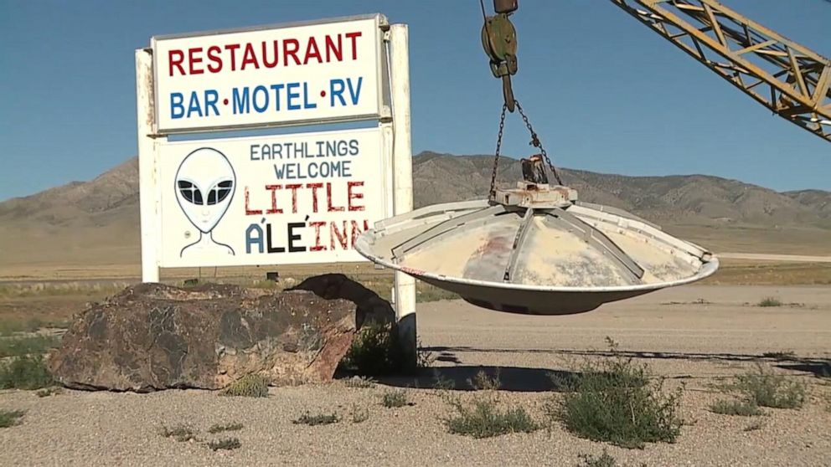
Activities in Area 51
Among the main activities in the area are the design, creation of new aircraft and test flights with them, as well as the study of foreign military aircraft, helicopters and weapons. Strong explosives, including nuclear weapons, were also tested there. The base has been declared a restricted area and all cars traveling nearby are closely monitored by military posts on the hills. Numerous cameras and geosensors are installed in the area.

Slide 5
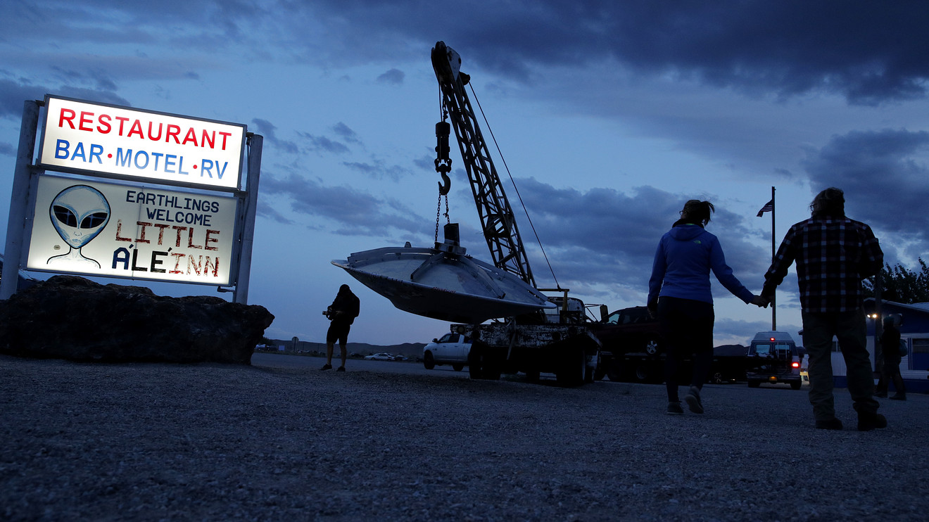
Employees
Most of the people who work in the area travel to and from work on a charter plane called Janet from Las Vegas. Due to the strict secrecy, nothing can leave the area - no garbage, no mail, no people. The only thing that concept lives in the area or passes tourist observation, with light at night or unusual flying objects. For a long time, only the government received a notification in Area 51, until photos of the database from a Russian spy plane became public.

Slide 6
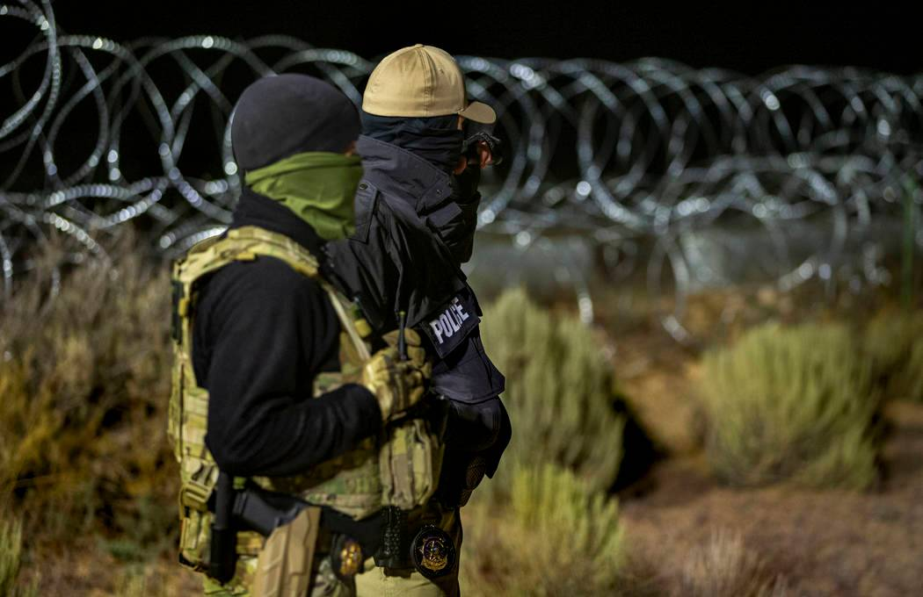
Security
The perimeter of the base is marked out by orange posts and patrolled by guards in white pickup trucks and camouflage fatigues. The guards are popularly referred to as "cammo dudes" by enthusiasts. The guards will not answer questions about their employers. However, according to the New York Daily News, there are indications they are employed through a contractor such as AECOM (the largest engineering company in the world). Signage around the base perimeter advises that deadly force is authorized against trespassers.

Slide 7
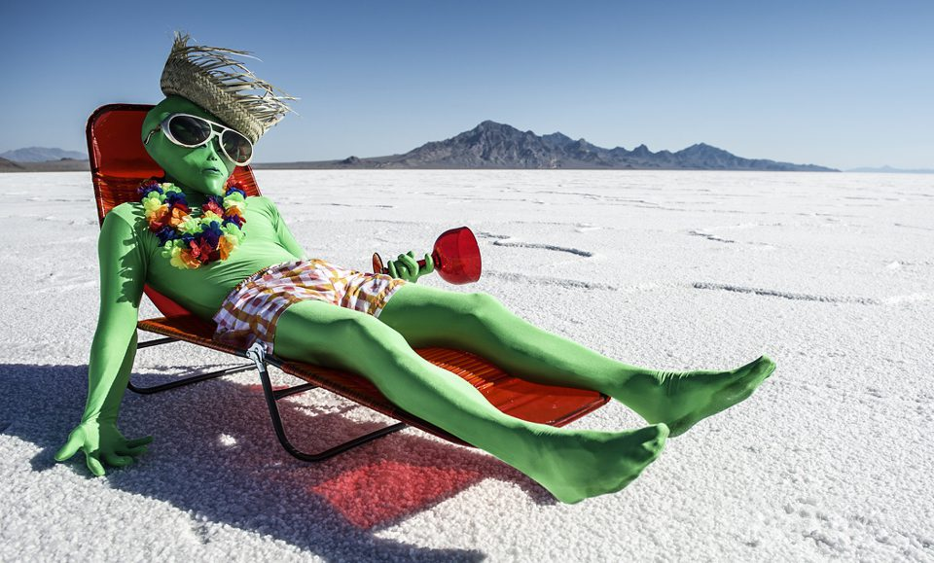
UFO and other conspiracy theories
Activities related to a shadowy one world government or the Majestic 12 organization.
The development of exotic energy weapons for the Strategic Defense Initiative (SDI) or other weapons programs.
The development of weather control.
The development of time travel and teleportation technology.
The development of exotic propulsion systems related to the Aurora Program.

Slide 8
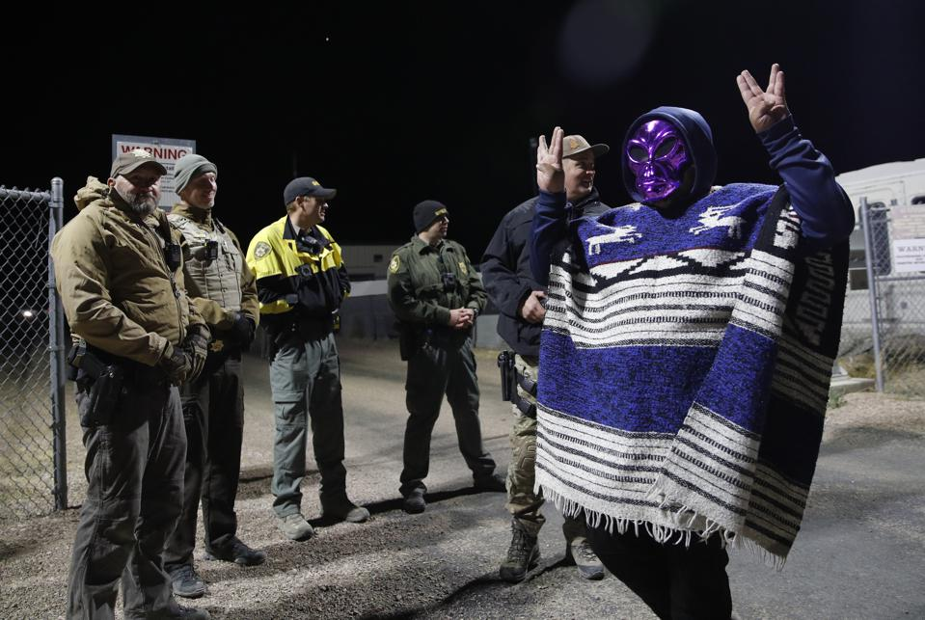
Interesting facts
It all started as a joke in July 2019 when more than 2,000,000 people responded to a proposal to storm Area 51 which appeared in an anonymous Facebook post. The event, scheduled for 20 September 2019, was billed as "Storm Area 51, They Can't Stop All of Us", an attempt to "see them aliens". Air Force spokeswoman Laura McAndrews said the government "would discourage anyone from trying to come into the area where we train American armed forces".

Slide 9
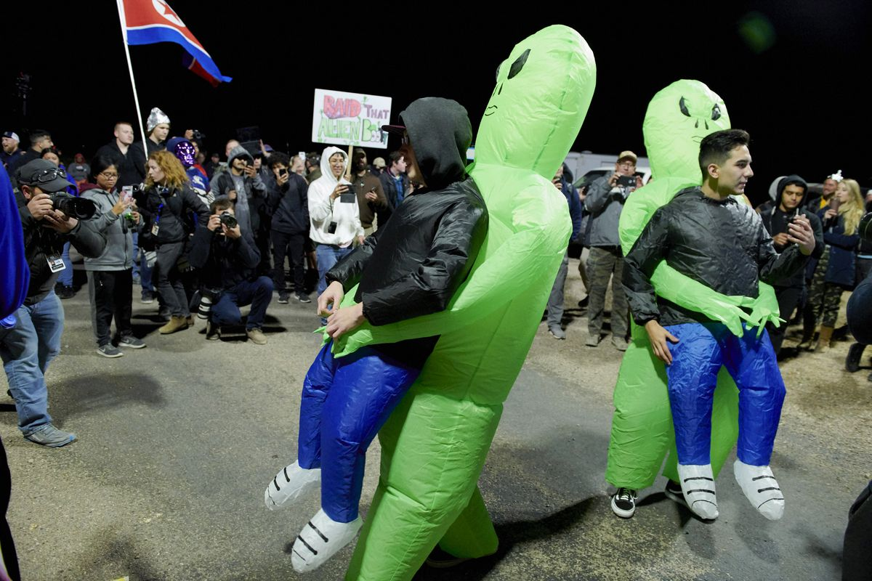
Two music festivals in rural Nevada, "AlienStock" and "Storm Area 51 Basecamp", were subsequently organized to capitalize on the popularity of the original Facebook event. Between 1,500 and 3,000 people showed up at the festivals, while over 150 people made the journey over several miles of rough roads to get near the gates to Area 51. Five people were reportedly arrested at the event.

Slide 10
Thanks for your attention!
Prepared by: Tony Todorov
Sources:
https://en.wikipedia.org/wiki/Area_51#cite_note-69
https://www.forbes.com/sites/lisettevoytko/2019/09/20/2-million-people-said-they-would-storm-area-51but-only-150-showed-up/?sh=13b3c11731b0
https://www.britannica.com/place/Area-51

